Slide 1
News Feed Application
Team 9-
Nidadhavolu Rajesh (2021sp93002) Shubham Sharma(2021sp93080)
Saddala Jahnavi (2021sp93071) Swaraj Kumar Mohapatra(2021sp93057)
Vamsi Krishna Kuncham (2021sp93055)

Slide 2
Features Of Application
Users can use social login (google account) to access the application
Users can select the preferences of their choice of news and can view latest news of choice
The users can ask questions on a forum so that others can answer.
The user can write blogs/articles about their experiences to share with others in a common public forum.
The user can like/dislike a blog or an answer.

Slide 3
Tech Stack
Frontend : -
For building the UI, we will be using Flutter ,Flutter is an open source framework by Google for
building beautiful, natively compiled, multi-platform applications from a single codebase.
Backend:-
For building the backend , we use Firebase which is a backend as a service by Google ,
Firebase provides authentication services, a NoSQL Database called Firestore, which we
can plug and play in our application
Apart form this we will be using third part news api to fetch news to display in our application
Platform – Web & Android

Slide 4
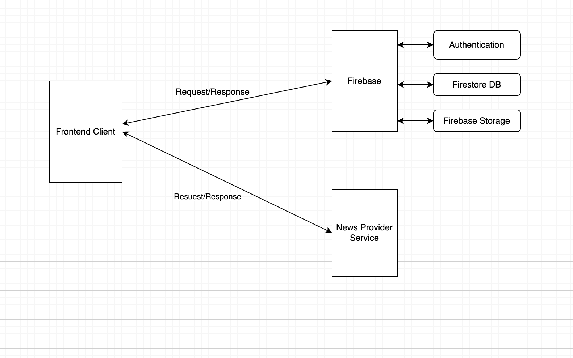
Architecture

Slide 5
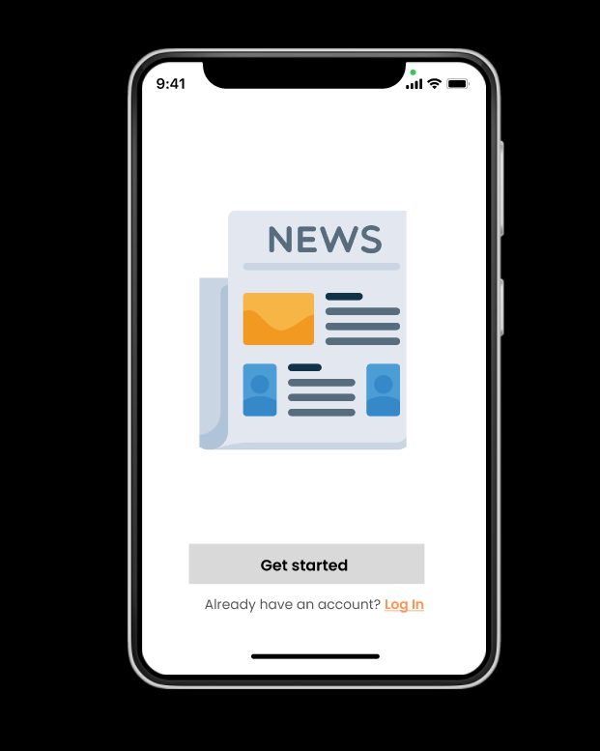
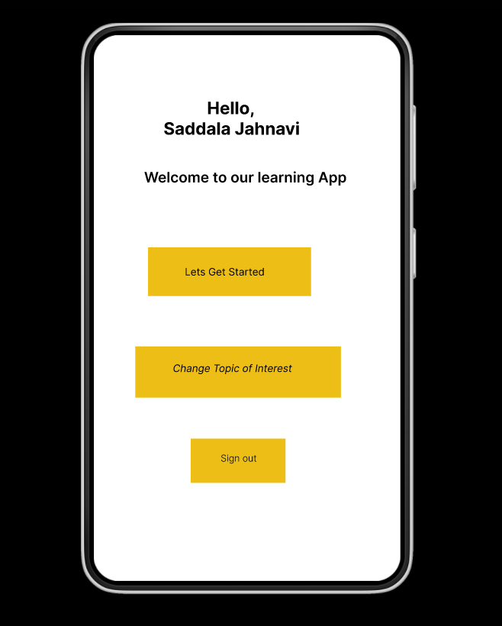
Prototype – Login screen

Slide 6
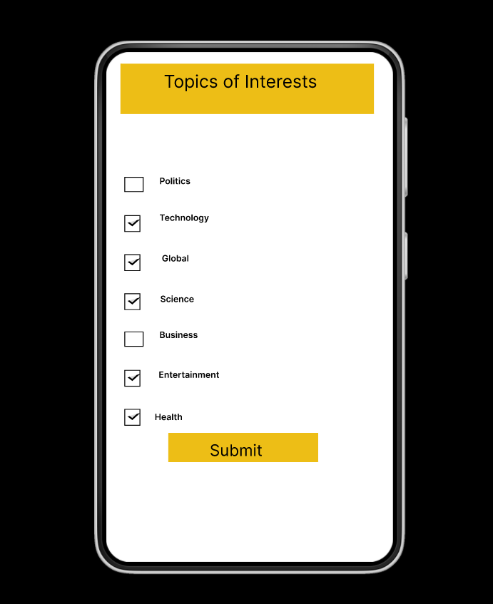
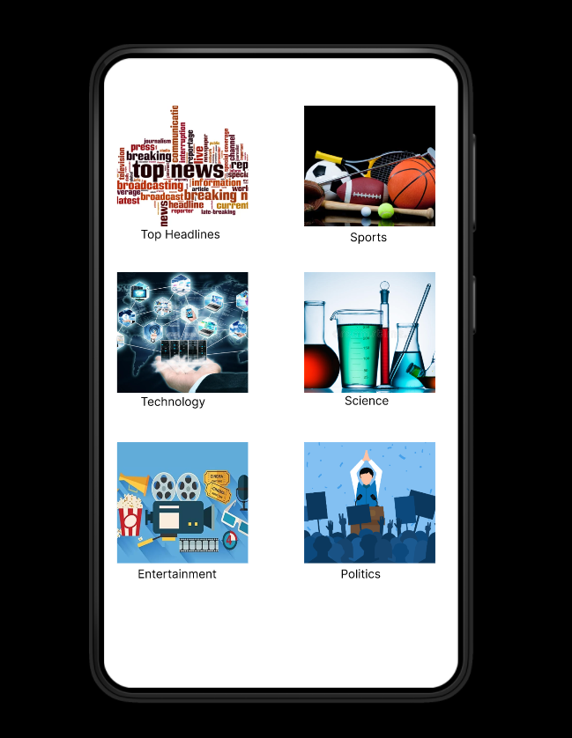
Home page

Slide 7
Thank You

